Slide 1
IT5005
Artificial Intelligence
Lecture 9: Uncertainty

Slide 2
Outline
Uncertainty
Probability
Syntax and Semantics
Inference
Independence and Bayes’ Rule

Slide 3
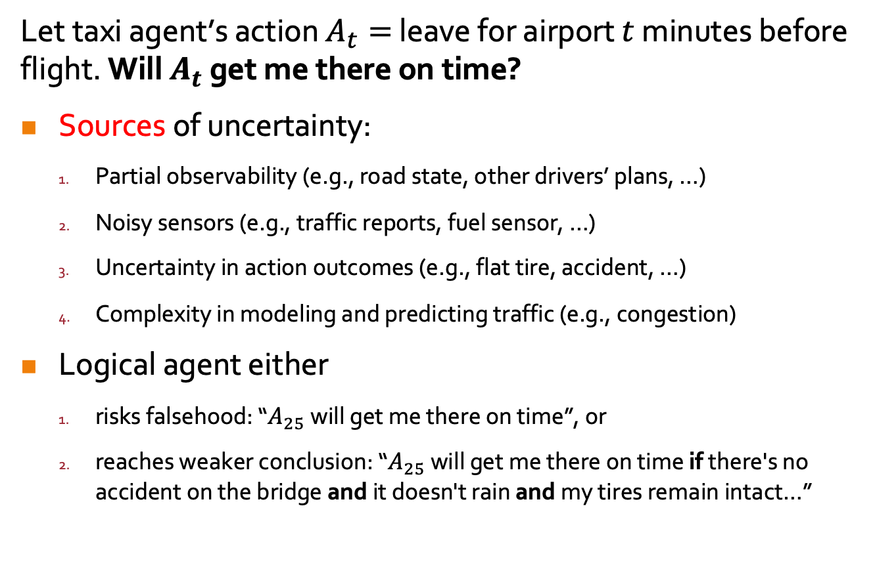
Uncertainty: Motivating Example
Let taxi agent’s action $A_{t}=$ leave for airport $t$ minutes before flight. Will $A_{t}$ get me there on time?
Sources of uncertainty:
  Partial observability (e.g., road state, other drivers’ plans, …)
  Noisy sensors (e.g., traffic reports, fuel sensor, …)
  Uncertainty in action outcomes (e.g., flat tire, accident, …)
  Complexity in modeling and predicting traffic (e.g., congestion)
Logical agent either
  risks falsehood: “$A_{25}$ will get me there on time”, or
  reaches weaker conclusion: “$A_{25}$ will get me there on time if there's no accident on the bridge and it doesn't rain and my tires remain intact…”
Notes:
2. Logical agent
2.1. cannot conclude with certainty that…,
2.2. weaker cos none of these conditions in the premise can be deduced with certainty, so the action’s success cannot be inferred.
(A₁₄₄₀ might reasonably be said to get me there on time but I'd have to stay overnight in the airport …)

Slide 4
Random Variables
Domains
Boolean: coin is either heads or tails (true or false)
Discrete: a die can have values $\left\{1,…,6\right\}$
Discrete: a die can have values {1,…,6}
Events: subsets of domains
$Even\left(X\right)$ the die has value $∈\{2,4,6\}$
𝐸𝑣𝑒𝑛(𝑋) the die has value ∈{2,4,6}
$Heads(X)$ the coin flipped to heads
𝐻𝑒𝑎𝑑𝑠(𝑋) the coin flipped to heads

Slide 5
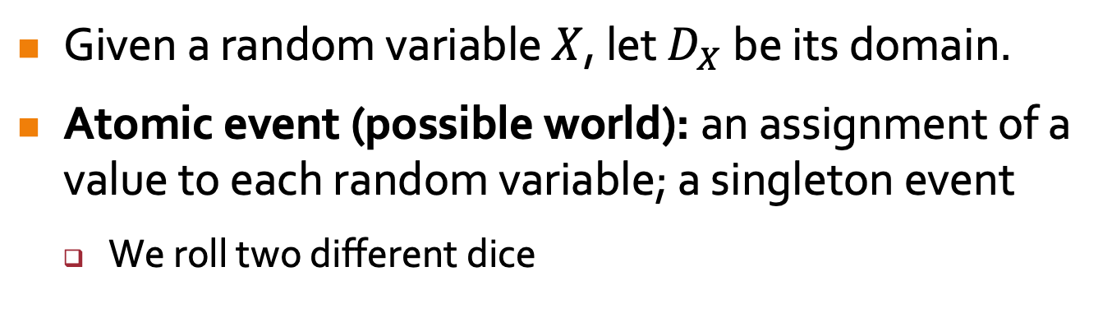
Events
Given a random variable $X$, let $D_{X}$ be its domain.
Atomic event (possible world): an assignment of a value to each random variable; a singleton event
  We roll two different dice
5
5
5
5

Slide 6
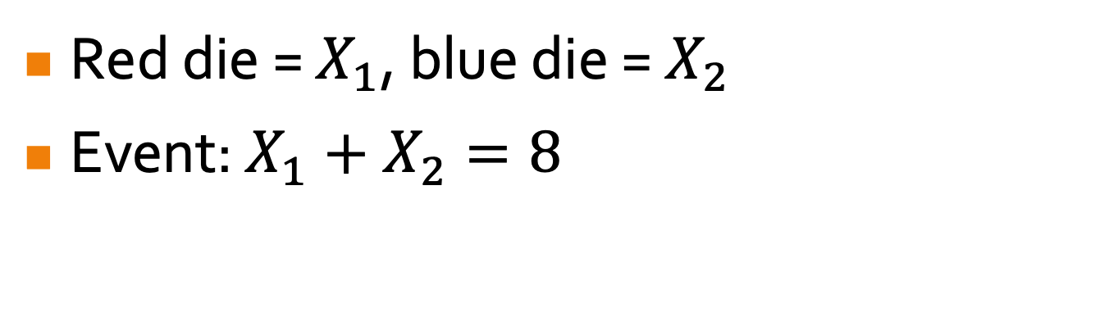
Events
Red die = $X_{1}$, blue die = $X_{2}$
Event: $X_{1}+X_{2}=8$
6
6
6
6

Slide 7
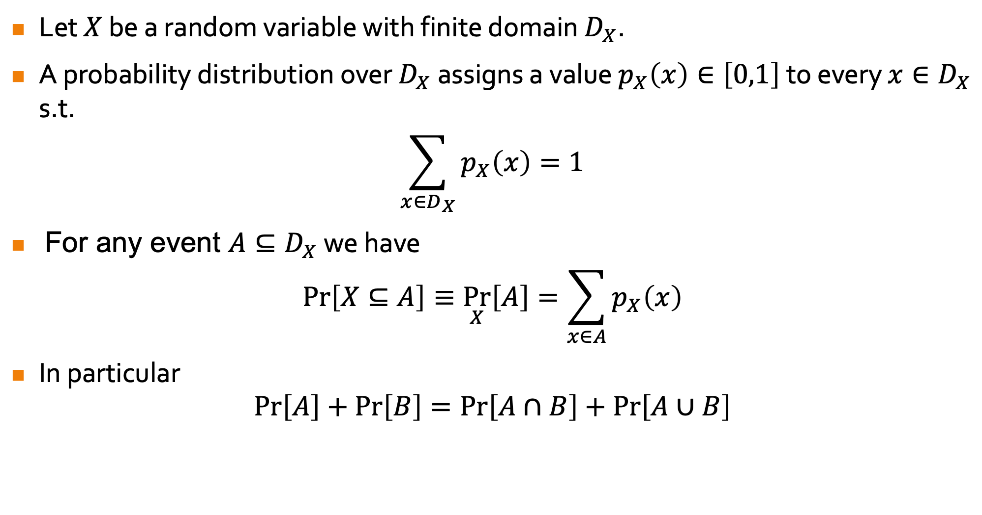


Axioms of Probability
Let $X$ be a random variable with finite domain $D_{X}$.
A probability distribution over $D_{X}$ assigns a value $p_{X}\left(x\right)∈\left[0,1\right]$ to every ${x∈D}_{X}$ s.t.
$$\sum_{x∈D_{X}}{p_{X}\left(x\right)}=1$$
For any event $A⊆D_{X}$ we have
$$\operatorname{Pr}\left[X⊆A\right]≡\underset{X}{Pr}\left[A\right]=\sum_{x∈A}{p_{X}\left(x\right)}$$
In particular
$$\operatorname{Pr}\left[A\right]+\operatorname{Pr}\left[B\right]=\operatorname{Pr}\left[A∩B\right]+\operatorname{Pr}\left[A∪B\right]$$
$$A$$
$$B$$

Slide 8
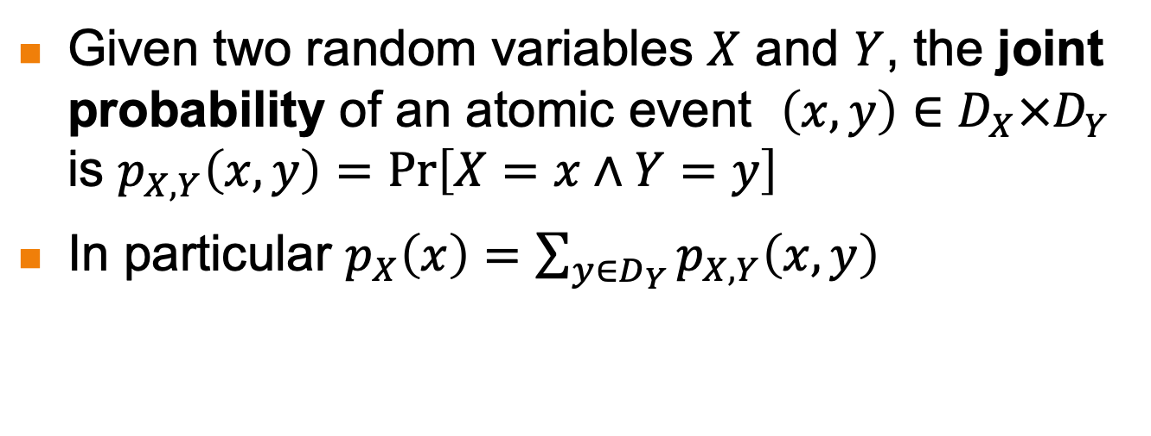
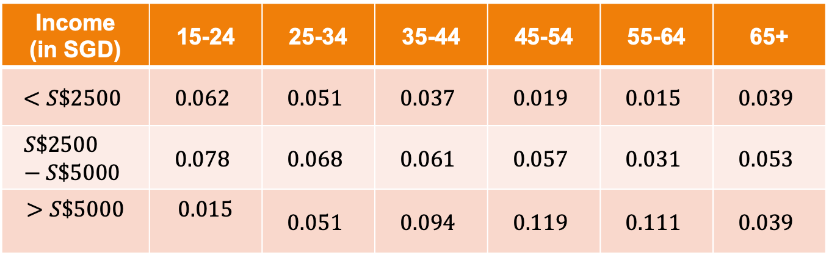
Joint Probability
Given two random variables $X$ and $Y$, the joint probability of an atomic event $\left(x,y\right)∈D_{X}×D_{Y}$ is $p_{X,Y}\left(x,y\right)=\operatorname{Pr}\left[X=x∧Y=y\right]$
In particular $p_{X}\left(x\right)=\sum_{y∈D_{Y}}{p_{X,Y}\left(x,y\right) }$
Income (in SGD) | 15-24 | 25-34 | 35-44 | 45-54 | 55-64 | 65+
$$<S\$2500$$ | $$0.062$$ | $$0.051$$ | $$0.037$$ | $$0.019$$ | $$0.015$$ | $$0.039$$
$$S\$2500−S\$5000$$ | $$0.078$$ | $$0.068$$ | $$0.061$$ | $$0.057$$ | $$0.031$$ | $$0.053$$
$$>S\$5000$$ | $$0.015$$ | $$0.051$$ | $$0.094$$ | $$0.119$$ | $$0.111$$ | $$0.039$$
$$\operatorname{Pr}\left[Age=\left(25−34\right)\right]=0.051+0.068+0.051=0.17$$

Slide 9
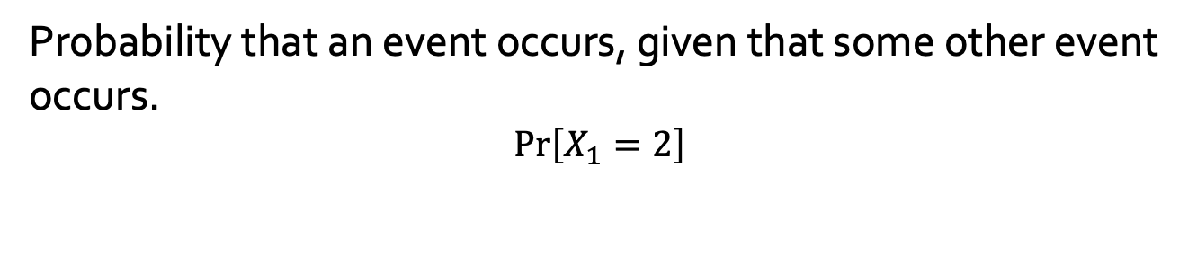
Posterior/Conditional Probability
Probability that an event occurs, given that some other event occurs.
$$\operatorname{Pr}\left[X_{1}=2\right]$$
9
9
9
9

Slide 10
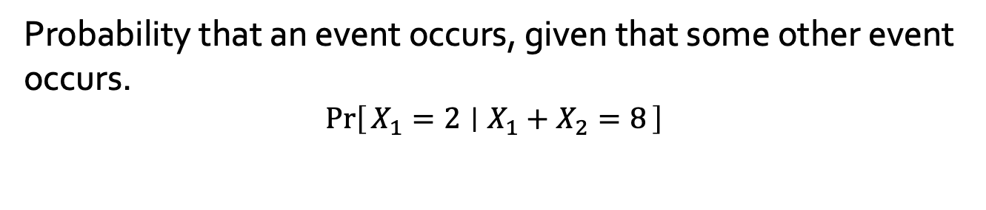
Posterior/Conditional Probability
Probability that an event occurs, given that some other event occurs.
$$\operatorname{Pr}\left[X_{1}=2 ∣ X_{1}+X_{2}=8\right]$$
10
10
10
10

Slide 11
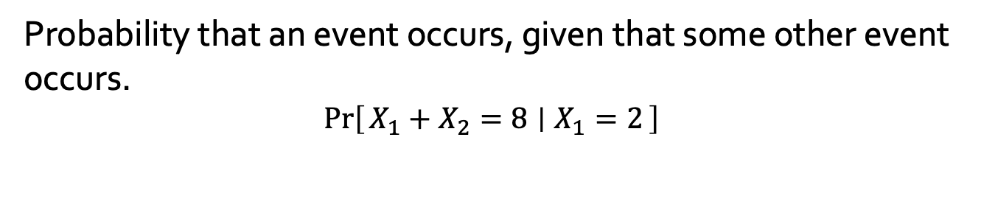
Posterior/Conditional Probability
Probability that an event occurs, given that some other event occurs.
$$\operatorname{Pr}\left[X_{1}+X_{2}=8 ∣ X_{1}=2\right]$$
11
11
11
11

Slide 12
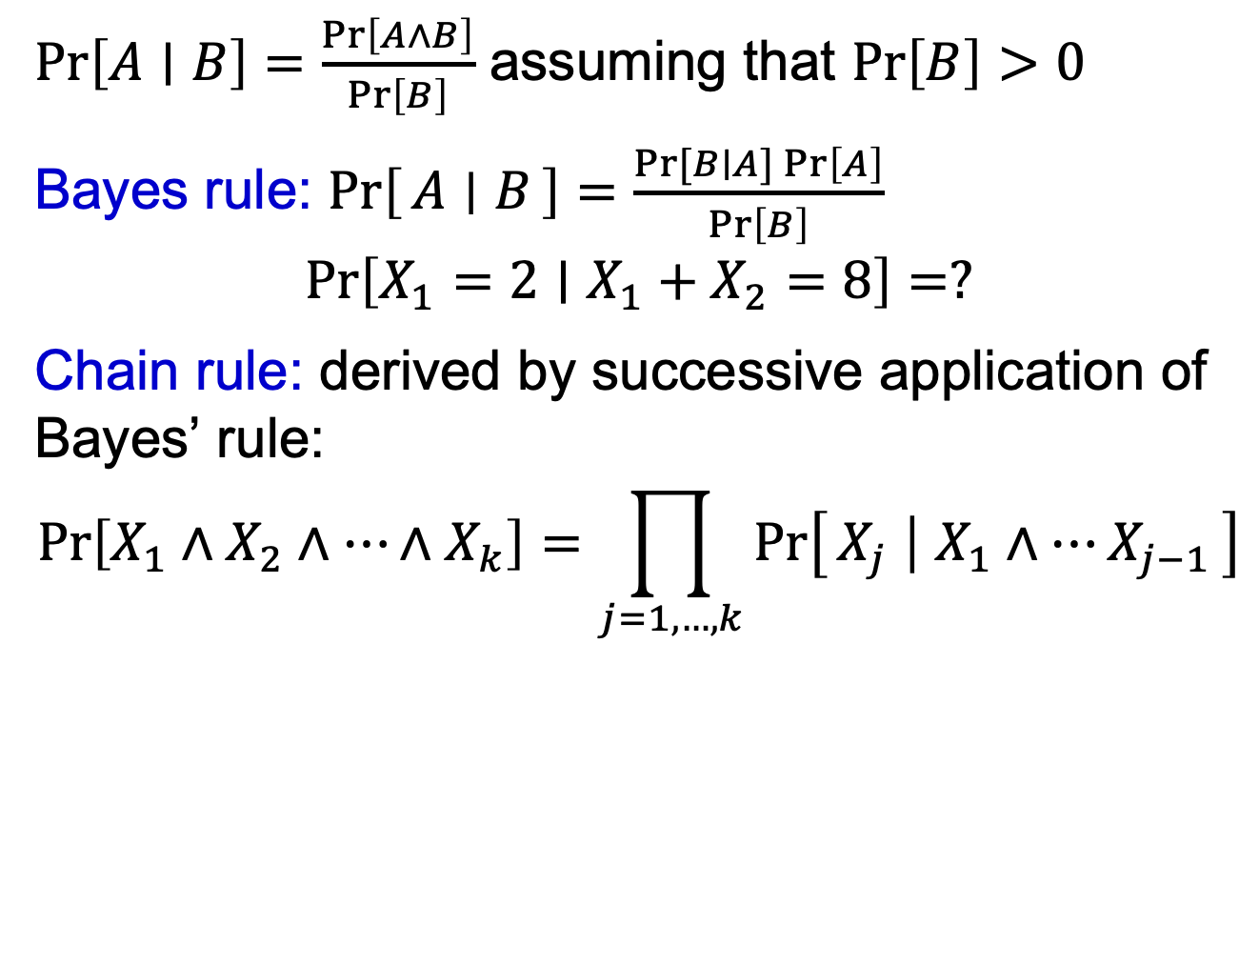
Posterior/Conditional Probability
$\operatorname{Pr}\left[A∣B\right]=\frac{\operatorname{Pr}\left[A∧B\right]}{\operatorname{Pr}\left[B\right]}$ assuming that $\operatorname{Pr}\left[B\right]>0$
Bayes rule: $\operatorname{Pr}\left[A ∣ B\right]=\frac{\operatorname{Pr}{[B∣A]}\operatorname{Pr}\left[A\right]}{\operatorname{Pr}\left[B\right]}$
$$\operatorname{Pr}\left[X_{1}=2∣X_{1}+X_{2}=8\right]=?$$
Chain rule: derived by successive application of Bayes’ rule:
$$\operatorname{Pr}\left[X_{1}∧X_{2}∧…∧X_{k}\right]=\prod_{j=1,…,k}{\operatorname{Pr}\left[X_{j} ∣ X_{1}∧…X_{j−1}\right]}$$

Slide 13
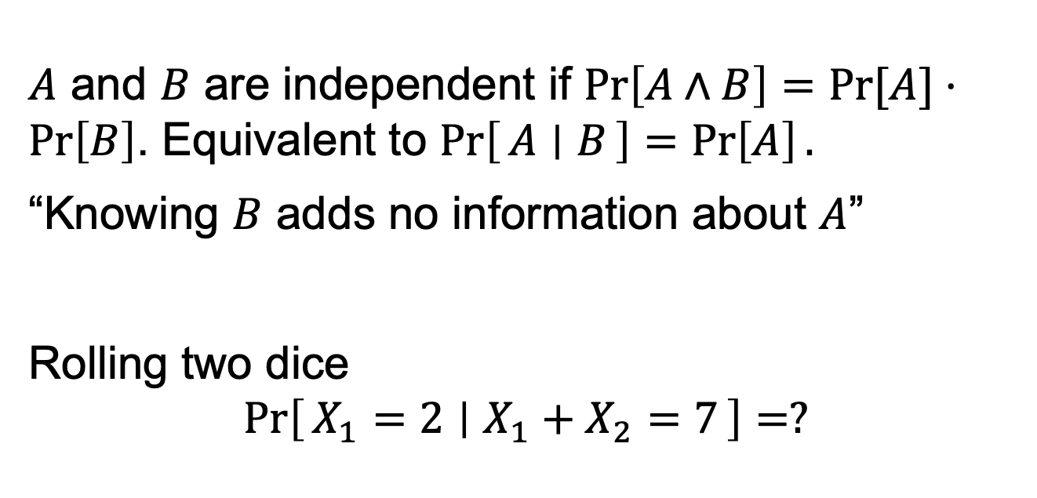
Independence
$A$ and $B$ are independent if $\operatorname{Pr}\left[A∧B\right]=\operatorname{Pr}{[A]}⋅\operatorname{Pr}\left[B\right]$. Equivalent to $\operatorname{Pr}\left[A ∣ B\right]=\operatorname{Pr}\left[A\right].$
“Knowing $B$ adds no information about $A$”
Rolling two dice
$$\operatorname{Pr}\left[X_{1}=2 ∣ X_{1}+X_{2}=7\right]=?$$

Slide 14
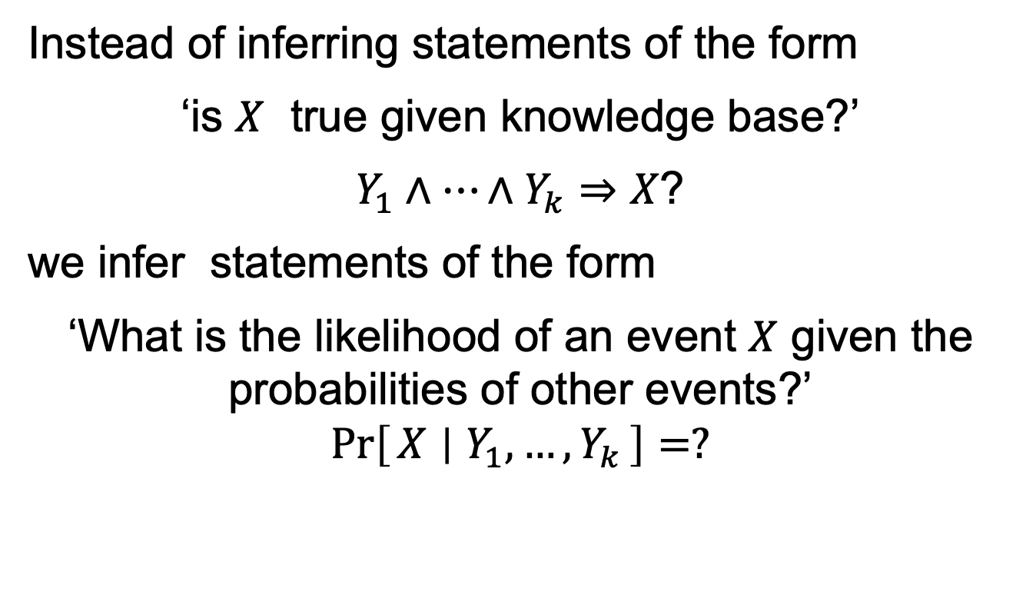
Bayesian Inference
Instead of inferring statements of the form
‘is $X$ true given knowledge base?’
$Y_{1}∧…∧Y_{k}⇒X$?
we infer statements of the form
‘What is the likelihood of an event $X$ given the probabilities of other events?’
$$\operatorname{Pr}\left[X ∣ Y_{1},…,Y_{k}\right]=?$$

Slide 15
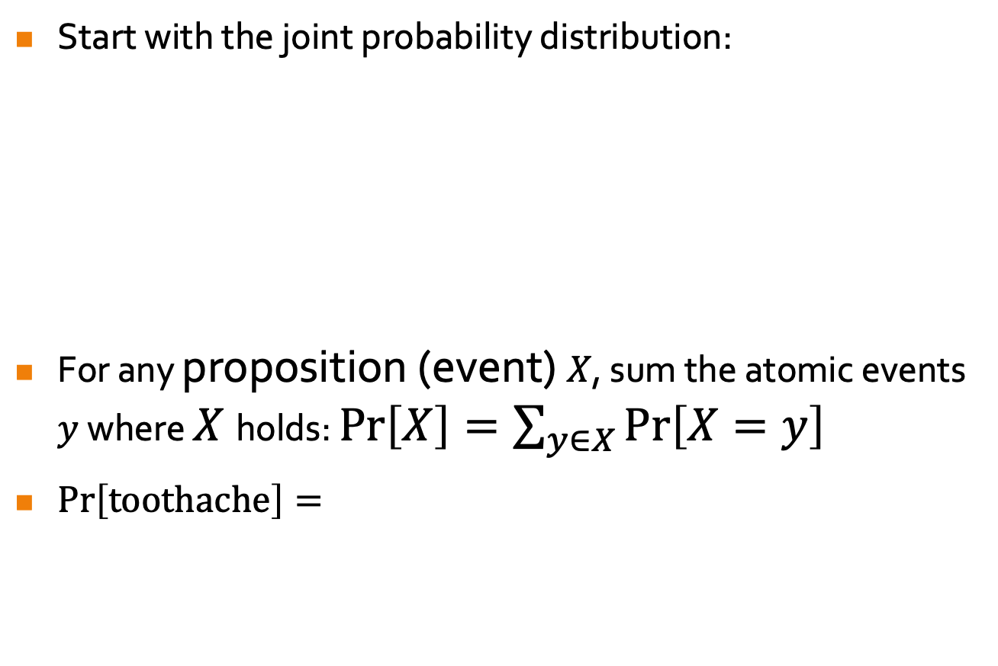
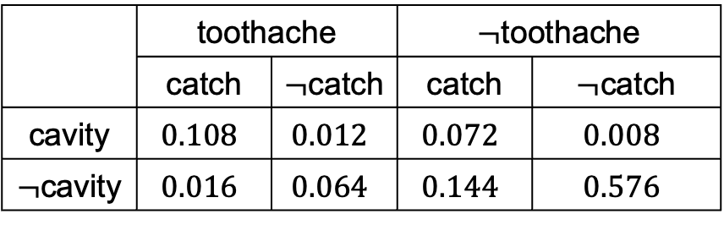
Inference by Enumeration
Start with the joint probability distribution:
For any proposition (event) $X$, sum the atomic events $y$ where $X$holds: $Pr\left[X\right]=\sum_{y∈X}{\operatorname{Pr}\left[X=y\right]}$
$\operatorname{Pr}\left[toothache\right]=$
 | toothache |  | $¬$toothache
 | catch | $¬$catch | catch | $¬$catch
cavity | $$0.108$$ | $$0.012$$ | $$0.072$$ | $$0.008$$
$¬$cavity | $$0.016$$ | $$0.064$$ | $$0.144$$ | $$0.576$$
$$0.108+0.016+0.012+0.064=0.2$$

Slide 16
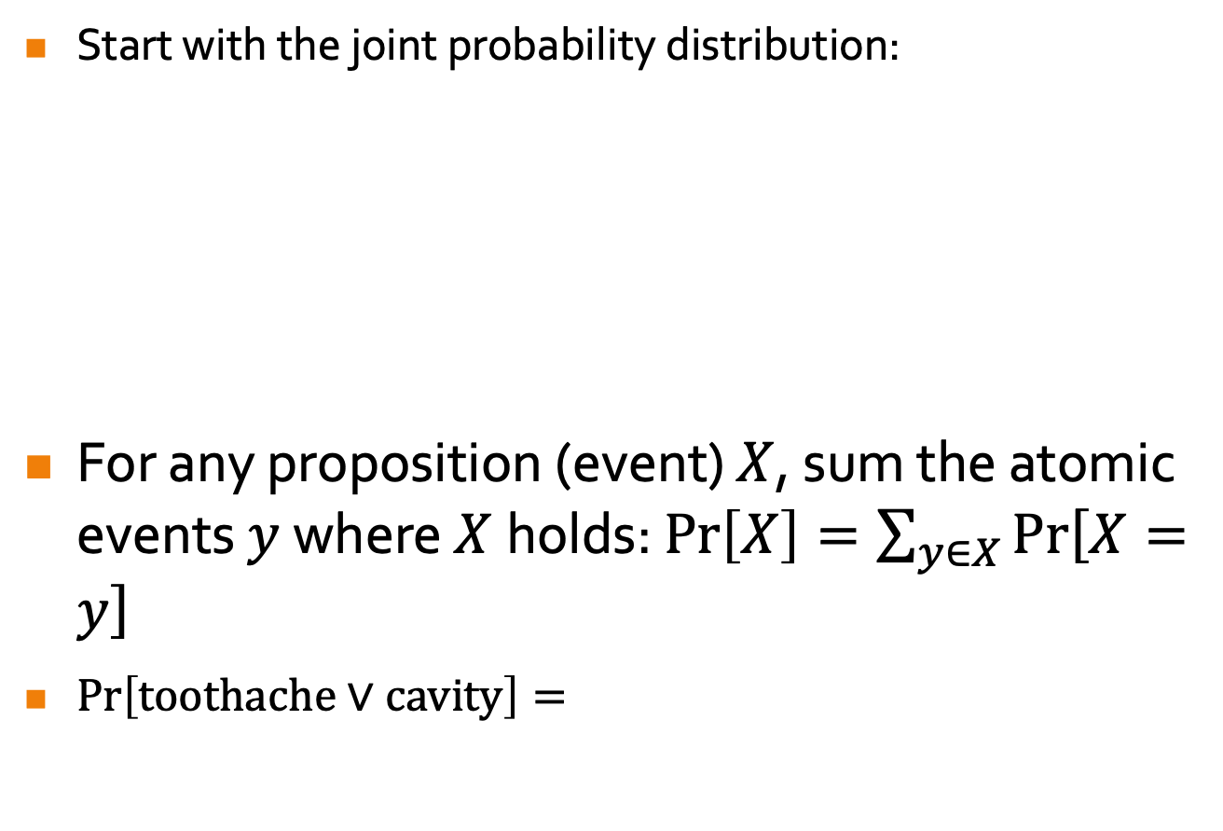
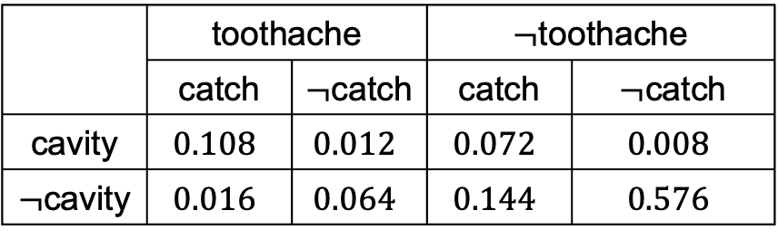
Inference by Enumeration
Start with the joint probability distribution:
For any proposition (event) $X$, sum the atomic events $y$ where $X$holds: $Pr\left[X\right]=\sum_{y∈X}{\operatorname{Pr}\left[X=y\right]}$
$\operatorname{Pr}\left[toothache∨cavity\right]=$
 | toothache |  | $¬$toothache
 | catch | $¬$catch | catch | $¬$catch
cavity | $$0.108$$ | $$0.012$$ | $$0.072$$ | $$0.008$$
$¬$cavity | $$0.016$$ | $$0.064$$ | $$0.144$$ | $$0.576$$

Slide 17


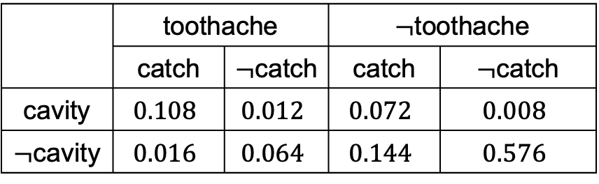
Inference by Enumeration
Start with the joint probability distribution:
For any proposition (event) $X$, sum the atomic events $y$ where $X$holds: $Pr\left[X\right]=\sum_{y∈X}{\operatorname{Pr}\left[X=y\right]}$
$\operatorname{Pr}\left[¬cavity∣toothache\right]=$
 | toothache |  | $¬$toothache
 | catch | $¬$catch | catch | $¬$catch
cavity | $$0.108$$ | $$0.012$$ | $$0.072$$ | $$0.008$$
$¬$cavity | $$0.016$$ | $$0.064$$ | $$0.144$$ | $$0.576$$
$$\frac{\operatorname{Pr}\left[¬cavity∧toothache\right]}{\operatorname{Pr}\left[toothache\right]}$$

Slide 18
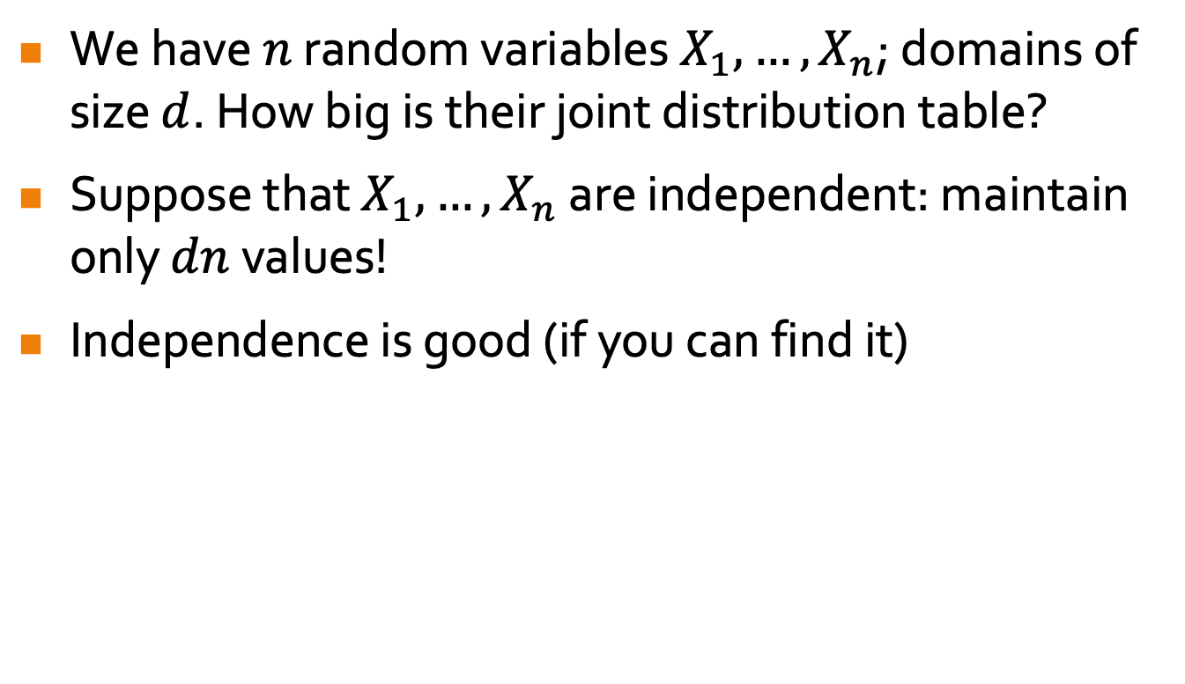
The Power of Independence
We have $n$ random variables $X_{1},…,X_{n}$; domains of size $d$. How big is their joint distribution table?
Suppose that $X_{1},…,X_{n}$ are independent: maintain only $dn$ values!
Independence is good (if you can find it)

Slide 19
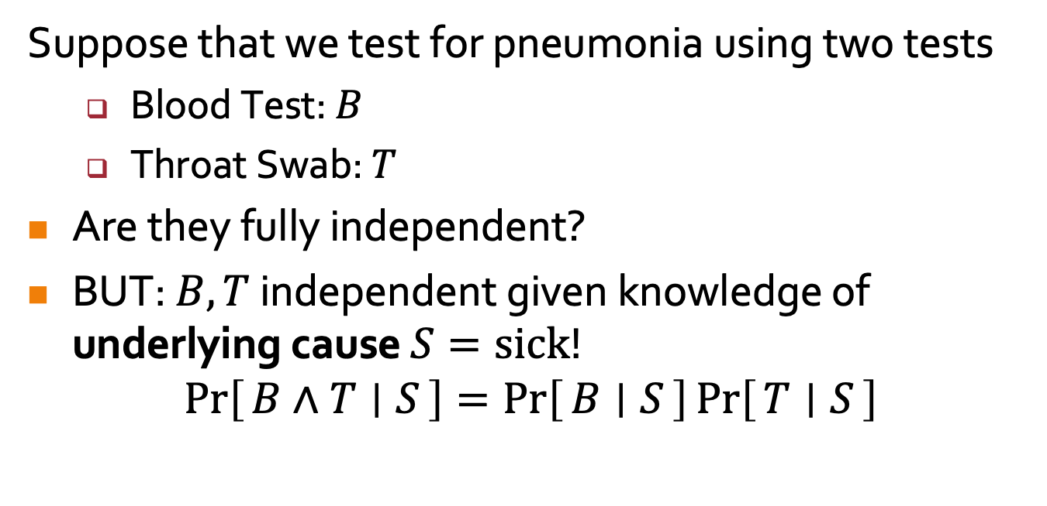
Conditional Independence
Suppose that we test for pneumonia using two tests
  Blood Test: $B$
  Throat Swab: $T$
Are they fully independent?
BUT: $B,T$ independent given knowledge of underlying cause $S=sick$!
$$\operatorname{Pr}\left[B∧T ∣ S\right]=\operatorname{Pr}\left[B ∣ S\right]\operatorname{Pr}\left[T ∣ S\right]$$
“Tests were conducted independently, only related by the underlying sickness”

Slide 20
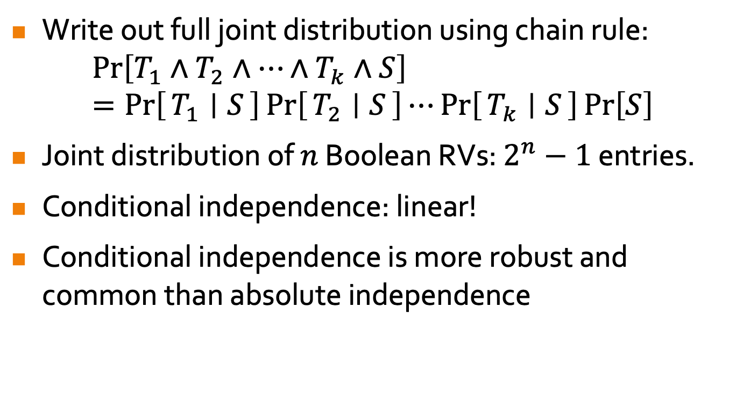
Conditional Independence
Write out full joint distribution using chain rule:
$$\operatorname{Pr}\left[T_{1}∧T_{2}∧…∧T_{k}∧S\right]=\operatorname{Pr}\left[T_{1} ∣ S\right]\operatorname{Pr}\left[T_{2} ∣ S\right]⋯\operatorname{Pr}\left[T_{k} ∣ S\right]\operatorname{Pr}\left[S\right]$$
Joint distribution of $n$ Boolean RVs: $2^{n}−1$ entries.
Conditional independence: linear!
Conditional independence is more robust and common than absolute independence
Notes:
Conditional Independence makes it much easier to write out full joint probability distributions.

Slide 21

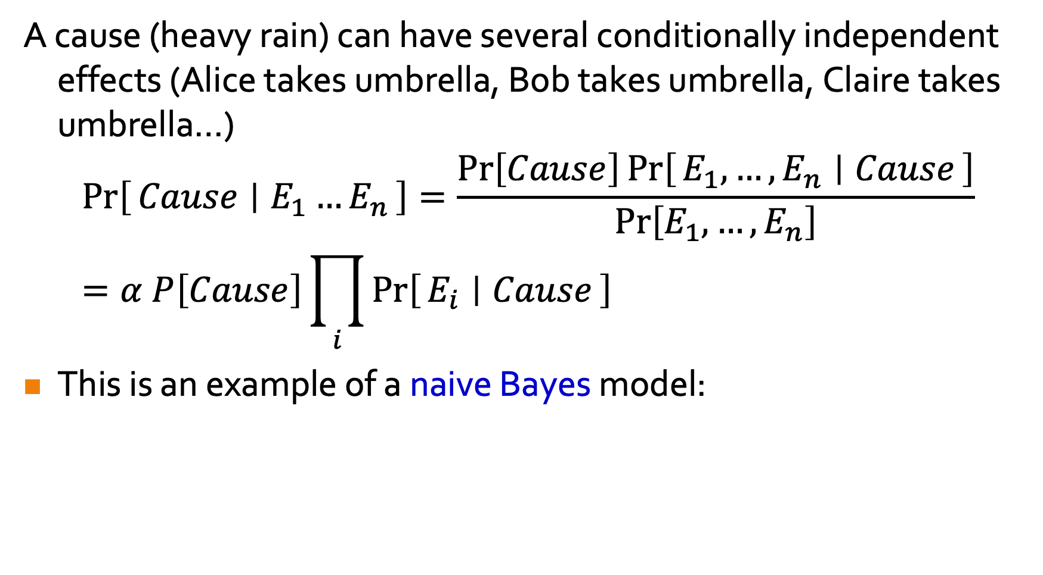



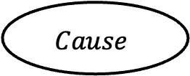
Bayes’ Rule and Conditional Independence
A cause (heavy rain) can have several conditionally independent effects (Alice takes umbrella, Bob takes umbrella, Claire takes umbrella…)
$$\operatorname{Pr}\left[Cause ∣ E_{1}…E_{n}\right]=\frac{\operatorname{Pr}\left[Cause\right]\operatorname{Pr}\left[E_{1},…,E_{n} ∣ Cause\right]}{\operatorname{Pr}\left[E_{1},…,E_{n}\right]}=α P\left[Cause\right]\prod_{i}{\operatorname{Pr}\left[E_{i} ∣ Cause\right]}$$
This is an example of a naive Bayes model:
$$Cause$$
$$E_{1}$$
$$E_{2}$$
$$…$$
$$E_{n}$$
Notes:
It’s often just useful to make a simplifying assumption that effects are independent given the cause (even though they’re not). This can be used at the very least to provide lower bounds on the probability of (mostly) conditionally independent events.

Slide 22
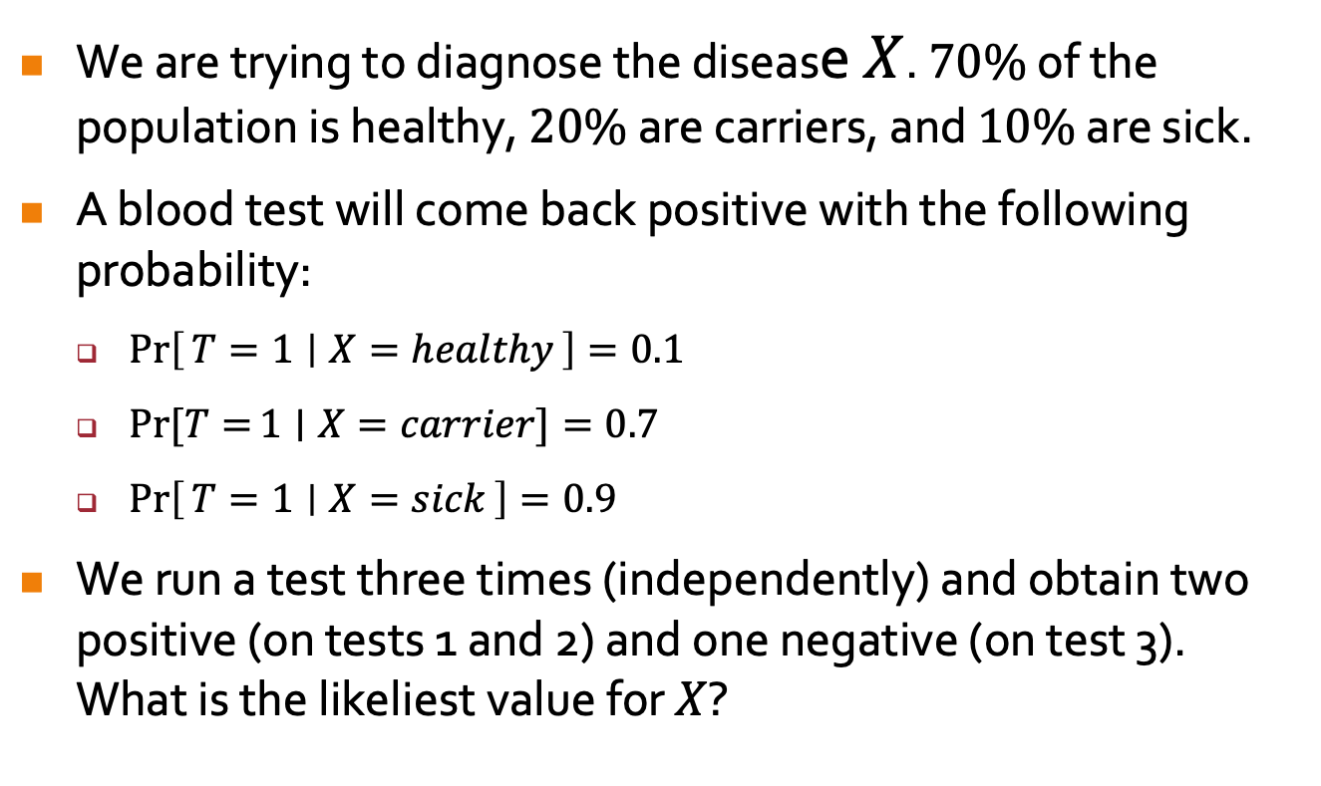
Normalization
We are trying to diagnose the disease $X$. $70\%$ of the population is healthy, $20\%$ are carriers, and $10\%$ are sick.
A blood test will come back positive with the following probability:
  $\operatorname{Pr}\left[T=1 ∣ X=healthy\right]=0.1$
  $\operatorname{Pr}{[T=}1∣X=carrier]=0.7$
  $\operatorname{Pr}\left[T=1 ∣ X=sick\right]=0.9$
We run a test three times (independently) and obtain two positive (on tests 1 and 2) and one negative (on test 3). What is the likeliest value for $X$?

Slide 23
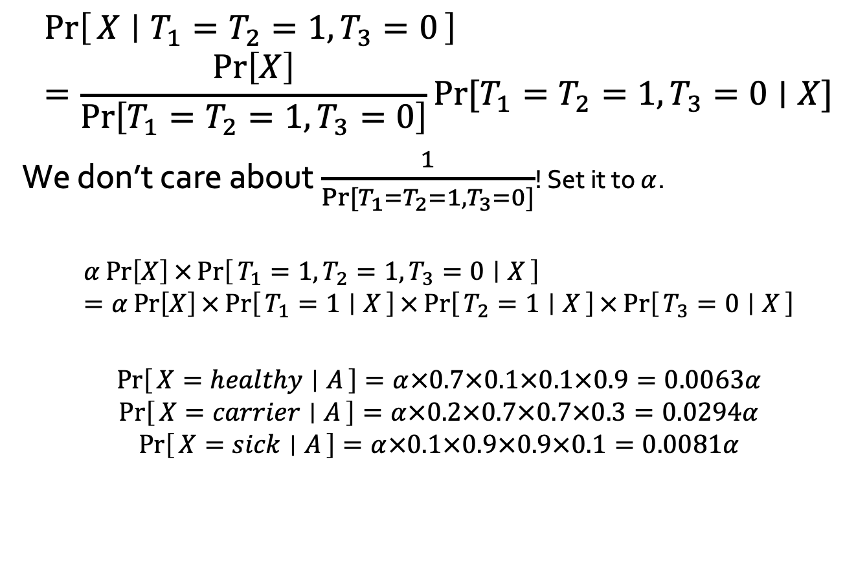
Normalization
$$\operatorname{Pr}\left[X ∣ T_{1}=T_{2}=1,T_{3}=0\right]=\frac{\operatorname{Pr}\left[X\right]}{\operatorname{Pr}\left[T_{1}=T_{2}=1,T_{3}=0\right]}\operatorname{Pr}{[T_{1}=T_{2}=1,T_{3}=0∣X]}$$
We don’t care about $\frac{1}{\operatorname{Pr}{[T_{1}=T_{2}=1,T_{3}=0]}}$! Set it to $α$.
$$α\operatorname{Pr}\left[X\right]×\operatorname{Pr}\left[T_{1}=1,T_{2}=1,T_{3}=0 ∣ X\right]=α\operatorname{Pr}\left[X\right]×\operatorname{Pr}\left[T_{1}=1 ∣ X\right]×\operatorname{Pr}\left[T_{2}=1 ∣ X\right]×\operatorname{Pr}\left[T_{3}=0 ∣ X\right]$$
$$\operatorname{Pr}\left[X=healthy ∣ A\right]=α×0.7×0.1×0.1×0.9=0.0063α$$
$$\operatorname{Pr}\left[X=carrier ∣ A\right]=α×0.2×0.7×0.7×0.3=0.0294α$$
$$\operatorname{Pr}\left[X=sick ∣ A\right]=α×0.1×0.9×0.9×0.1=0.0081α$$
Notes:
What’s the prob. that X occurs given two positive and one negative? It’s alpha times Pr[X]*Pr[T_1,T_2,T_3|X], which since T_1,T_2,T_3 are conditionally independent given X can be easily computed.

Slide 24
BAYESIAN NETWORKS
AIMA Chapter 14.1 – 14.2
Notes:
The entire module of CS5340 Uncertainty modeling in AI covers this topic.

Slide 25
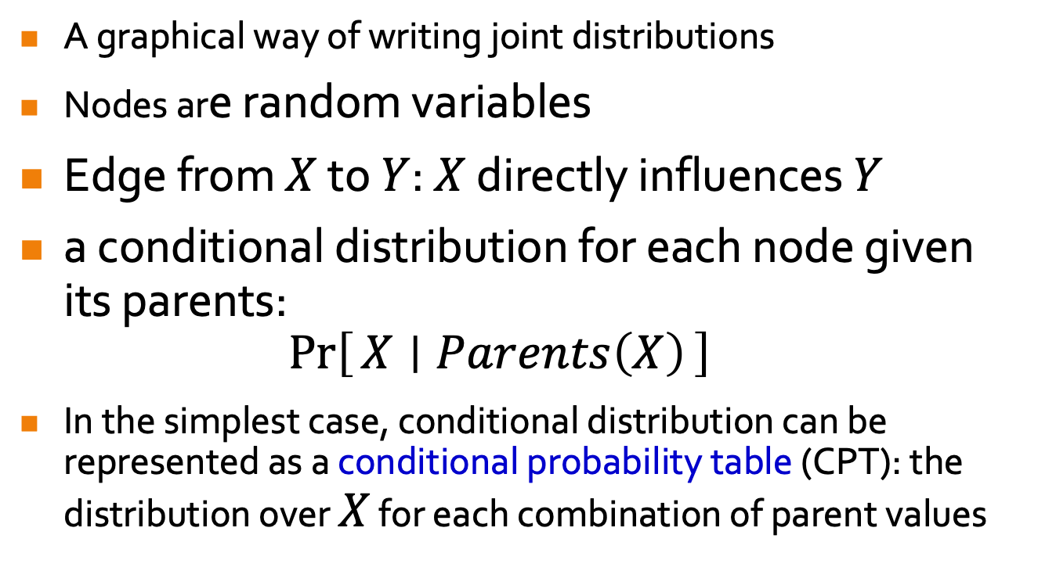
Bayesian Networks
A graphical way of writing joint distributions
Nodes are random variables
Edge from $X$ to $Y$: $X$ directly influences $Y$
a conditional distribution for each node given its parents:
$\operatorname{Pr}\left[X ∣ Parents\left(X\right)\right]$
In the simplest case, conditional distribution can be represented as a conditional probability table (CPT): the distribution over $X$ for each combination of parent values
Notes:
2.3. Arrow from Parent(Xi) to Xi

Slide 26
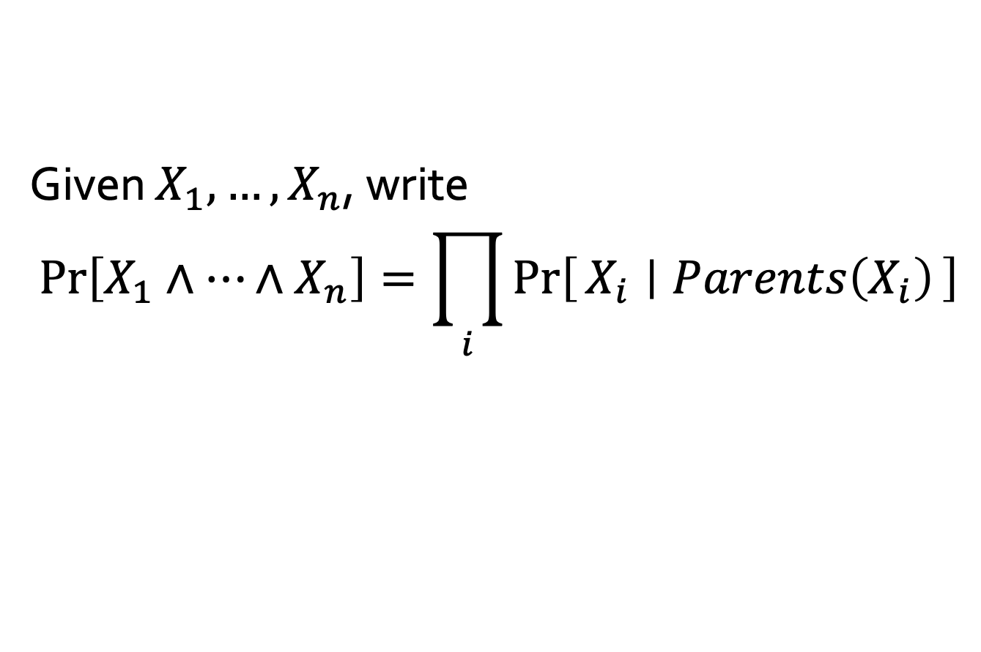
Bayesian Networks
Given $X_{1},…,X_{n}$, write
$$\operatorname{Pr}\left[X_{1}∧…∧X_{n}\right]=\prod_{i}{\operatorname{Pr}\left[X_{i} ∣ Parents\left(X_{i}\right)\right]}$$

Slide 27





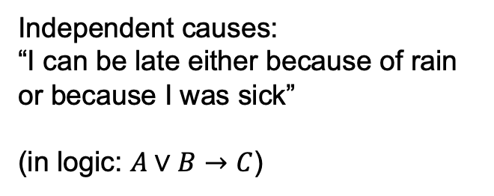


Examples
$\operatorname{Pr}{[A∧B∧C]}=\operatorname{Pr}\left[C ∣ A,B\right]\operatorname{Pr}\left[A\right]\operatorname{Pr}\left[B\right]$
$\operatorname{Pr}{[A∧B∧C]}=\operatorname{Pr}\left[C\right]\operatorname{Pr}\left[A\right]\operatorname{Pr}\left[B\right]$
Independent causes:
“I can be late either because of rain or because I was sick”
(in logic: $A∨B→C$)
$$A$$
$$B$$
$$C$$
$$A$$
$$B$$
$$C$$

Slide 28



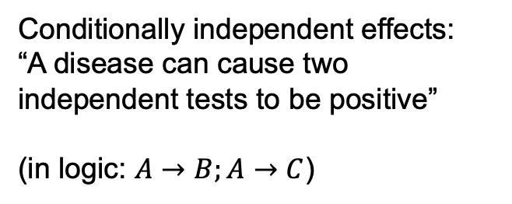

Examples
$\operatorname{Pr}{[A∧B∧C]}=\operatorname{Pr}\left[C ∣ A\right]\operatorname{Pr}\left[B∣A\right]\operatorname{Pr}\left[A\right]$
$\operatorname{Pr}{[A∧B∧C]}=\operatorname{Pr}\left[C∣B\right]\operatorname{Pr}\left[B∣A\right]\operatorname{Pr}\left[A\right]$
Conditionally independent effects:
“A disease can cause two independent tests to be positive”
(in logic: $A→B;A→C$)
$$A$$
$$B$$
$$C$$
$$A$$
$$B$$
$$C$$

Slide 29
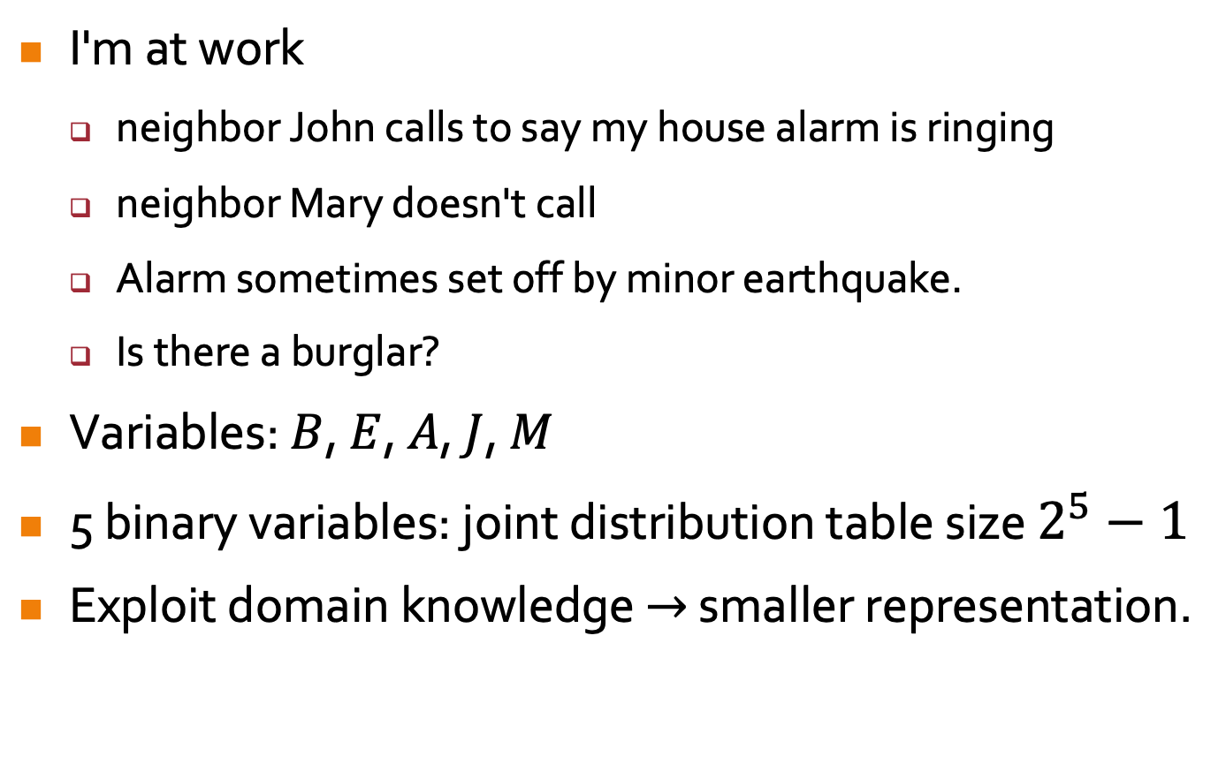
Example With More Variables
I'm at work
  neighbor John calls to say my house alarm is ringing
  neighbor Mary doesn't call
  Alarm sometimes set off by minor earthquake.
  Is there a burglar?
Variables: $B$, $E$, $A$, $J$, $M$
5 binary variables: joint distribution table size $2^{5}−1$
Exploit domain knowledge $→$ smaller representation.
Notes:
1. Specifically, since we’re into prob, what’s the prob of a burglar?

Slide 30
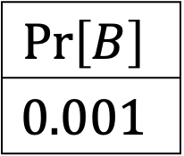


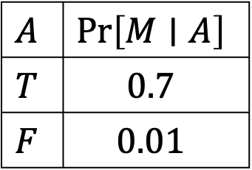

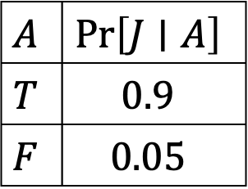
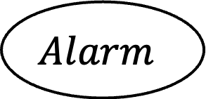
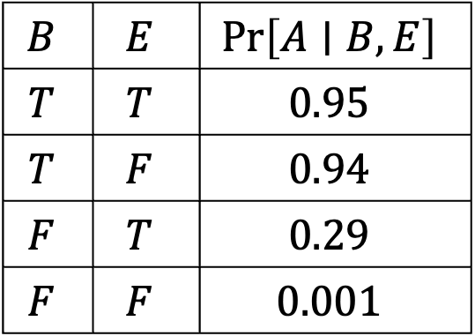

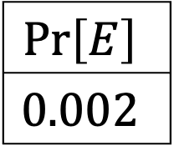
$$\operatorname{Pr}\left[B\right]$$
$$0.001$$
$$\operatorname{Pr}\left[E\right]$$
$$0.002$$
$$Burglary$$
$$Earthquake$$
$$B$$ | $$E$$ | $$\operatorname{Pr}\left[A∣B,E\right]$$
$$T$$ | $$T$$ | $$0.95$$
$$T$$ | $$F$$ | $$0.94$$
$$F$$ | $$T$$ | $$0.29$$
$$F$$ | $$F$$ | $$0.001$$
$$Alarm$$
$$A$$ | $$\operatorname{Pr}\left[M∣A\right]$$
$$T$$ | $$0.7$$
$$F$$ | $$0.01$$
$$A$$ | $$\operatorname{Pr}\left[J∣A\right]$$
$$T$$ | $$0.9$$
$$F$$ | $$0.05$$
$$JohnCalls$$
$$MaryCalls$$
Notes:
1. In CPTs, B, E, A, J, M stand for …
2. Assumptions (no links): (1) John and Mary do not perceive burglaries directly, (2) they do not notice minor earthquakes, (3) they do not comm before calling.
3. Should the numbers sum to 1? Is something missing?

Slide 31
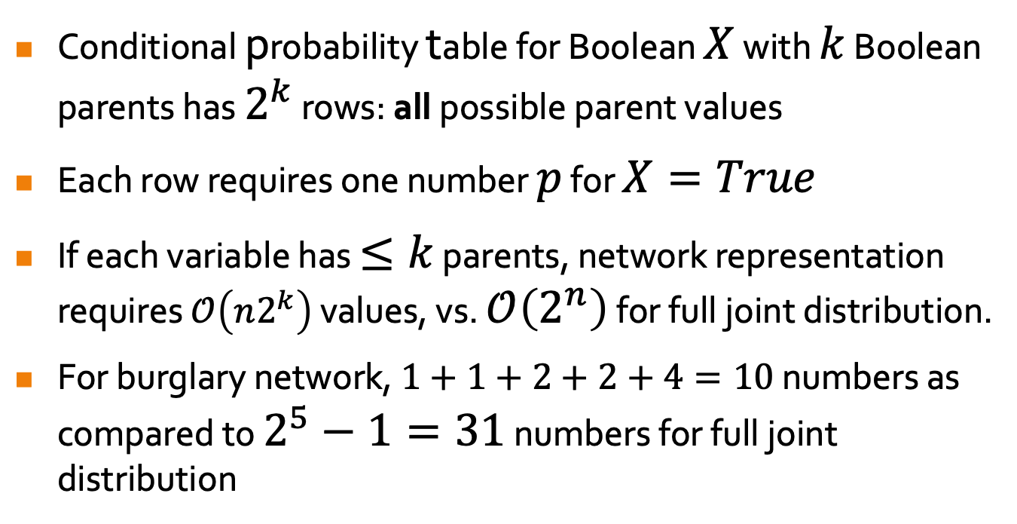
Bayesian Networks – Compactly Representing Joint Distributions
Conditional probability table for Boolean $X$ with $k$ Boolean parents has $2^{k}$ rows: all possible parent values
Each row requires one number $p$ for $X=True$
If each variable has $≤k$ parents, network representation requires $𝒪\left(n2^{k}\right)$ values, vs. $𝒪\left(2^{n}\right)$ for full joint distribution.
For burglary network, $1+1+2+2+4=10$ numbers as compared to $2^{5}−1=31$ numbers for full joint distribution
Notes:
3. Assuming n Boolean variables, this property of compactness allows BN to represent very large domains.

Slide 32
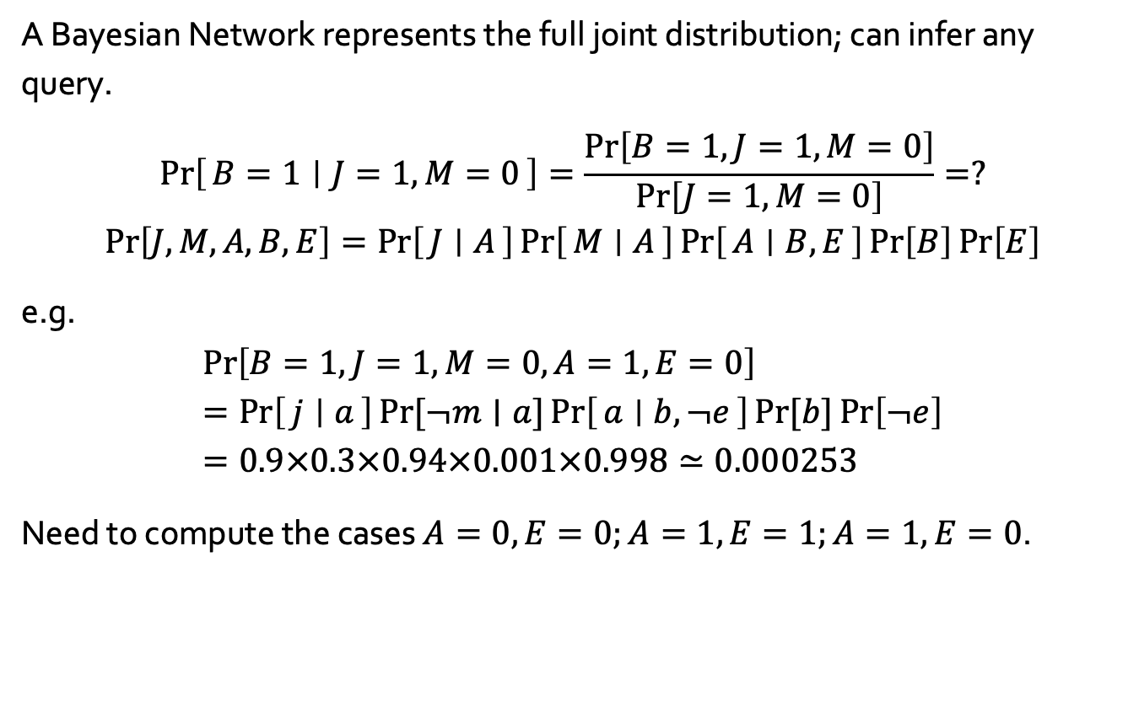
Inference in Bayesian Networks
A Bayesian Network represents the full joint distribution; can infer any query.
$$\operatorname{Pr}\left[B=1 ∣ J=1,M=0\right]=\frac{\operatorname{Pr}\left[B=1,J=1,M=0\right]}{\operatorname{Pr}\left[J=1,M=0\right]}=?$$
$$\operatorname{Pr}\left[J,M,A,B,E\right]=\operatorname{Pr}\left[J ∣ A\right]\operatorname{Pr}\left[M ∣ A\right]\operatorname{Pr}\left[A ∣ B,E\right]\operatorname{Pr}\left[B\right]\operatorname{Pr}\left[E\right]$$
e.g.
$$\operatorname{Pr}\left[B=1,J=1,M=0,A=1,E=0\right]=\operatorname{Pr}\left[j ∣ a\right]\operatorname{Pr}{[¬m∣a]}\operatorname{Pr}\left[a ∣ b,¬e\right]\operatorname{Pr}{[b}]\operatorname{Pr}\left[¬e\right]=0.9×0.3×0.94×0.001×0.998≃0.000253$$
Need to compute the cases $A=0,E=0;A=1,E=1;A=1,E=0$.
Notes:
0(a) BN is a compact representation of the full joint prob distribution.
0(b) Recall that full joint dist can be used to answer any query about the domain. So, BN too can be used to answer any query, by summing the relevant joint entries.
0(c) Full joint prob dist is factored into a product of local conditional prob dist.
Example: alarm has sounded, John and Mary call, no burglary, no earthquake

Slide 33
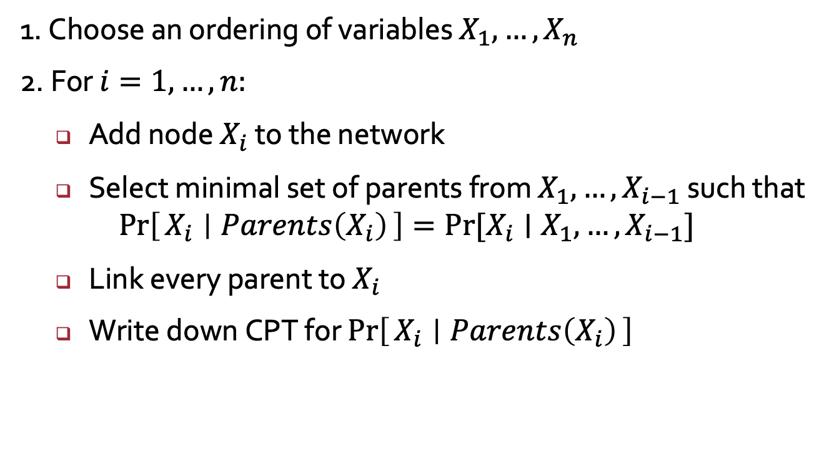
Constructing Bayesian Networks
1. Choose an ordering of variables $X_{1},…,X_{n}$
2. For $i=1,…,n:$
  Add node $X_{i}$ to the network
  Select minimal set of parents from $X_{1},…,X_{i−1}$ such that
  $\operatorname{Pr}\left[X_{i} ∣ Parents\left(X_{i}\right)\right]=\operatorname{Pr}{[X_{i}∣X_{1},…,X_{i−1}]}$
  Link every parent to $X_{i}$
  Write down CPT for $\operatorname{Pr}\left[X_{i} ∣ Parents\left(X_{i}\right)\right]$

Slide 34
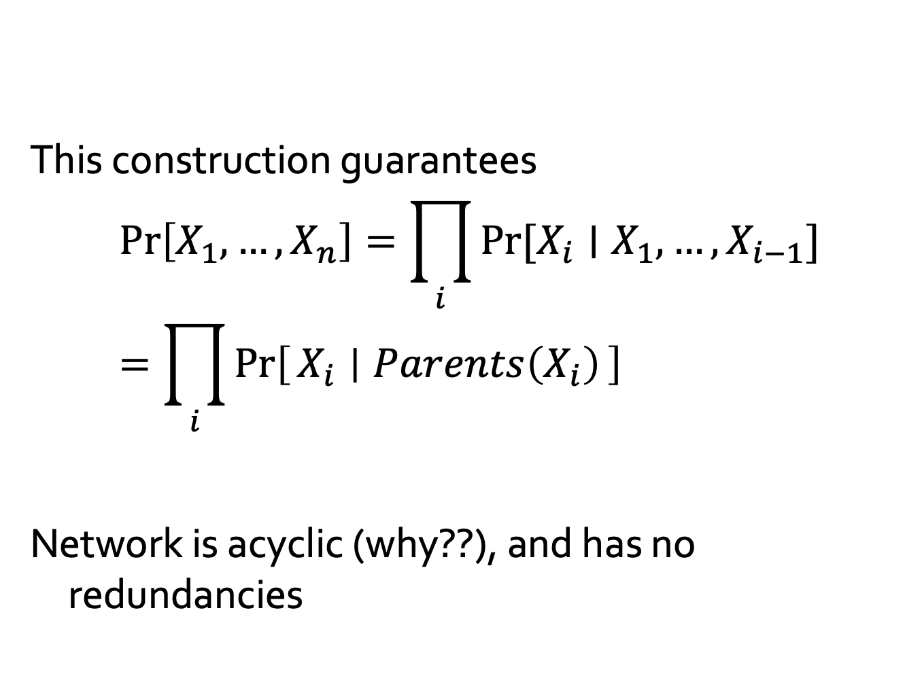
Constructing Bayesian Networks
Consequence of chain rule, generally true!
This construction guarantees
$$\operatorname{Pr}\left[X_{1},…,X_{n}\right]=\prod_{i}{\operatorname{Pr}{[X_{i}∣X_{1},…,X_{i−1}]}}=\prod_{i}{\operatorname{Pr}\left[X_{i} ∣ Parents\left(X_{i}\right)\right]}$$
Network is acyclic (why??), and has no redundancies
By choice of parents

Slide 35




Variable Order Matters
We choose the ordering $M, J, A, B, E$ (originally was $B,E,A,M,J$)
$$MaryCalls$$
$$JohnCalls$$
Is it true that $\operatorname{Pr}{[J∣M]}=\operatorname{Pr}{[J}]$?

Slide 36

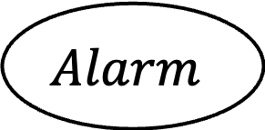
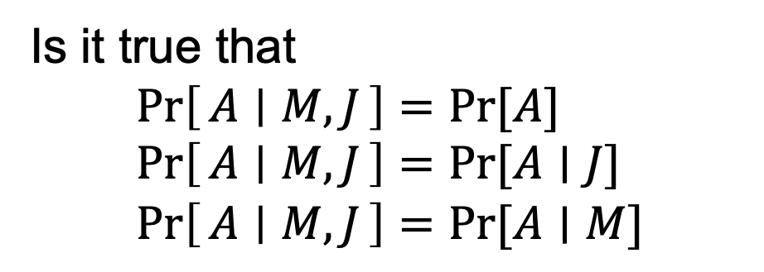
Variable Order Matters
We choose the ordering $M, J, A, B, E$
$$MaryCalls$$
$$JohnCalls$$
$$Alarm$$
Is it true that
$$\operatorname{Pr}\left[A ∣ M,J\right]=\operatorname{Pr}{[A}] \\ \operatorname{Pr}\left[A ∣ M,J\right]=\operatorname{Pr}{[A∣J}] \\ \operatorname{Pr}\left[A ∣ M,J\right]=\operatorname{Pr}{[A∣M}]$$

Slide 37

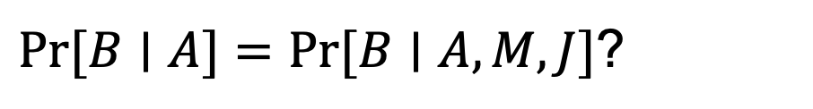
Variable Order Matters
We choose the ordering $M, J, A, B, E$
$$MaryCalls$$
$$JohnCalls$$
$$Alarm$$
$\operatorname{Pr}{[B∣A]}=\operatorname{Pr}{[B∣A,M,J}]$?
$$Burglary$$

Slide 38
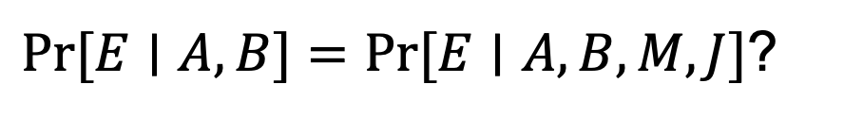

Variable Order Matters
We choose the ordering $M, J, A, B, E$
$$MaryCalls$$
$$JohnCalls$$
$$Alarm$$
$$Earthquake$$
$$Burglary$$
$\operatorname{Pr}{[E∣A,B]}=\operatorname{Pr}{[E∣A,B,M,J}]$?
Notes:
1(a) Previously, we chose the ordering B, E, A, J, M.
1(b) Let’s see if we get back the same BN.
1(c) Adding MaryCalls: No parents
1(d) Adding JohnCalls: If Mary calls, that probably means the alarm has gone off, which of course would make it more likely that John calls. Therefore, JohnCalls needs MaryCalls as a parent.

Slide 39









The Markov Blanket
A node is conditionally independent of everything else given the values of its:
  parents
  children
  its children’s parents
$$P_{1}$$
$$…$$
$$P_{m}$$
$$X$$
$$Q_{11}$$
$$Q_{k1}$$
$$C_{1}$$
$$…$$
$$C_{k}$$
Notes:
0. In fact, the topology tells us more about the CI properties.
non-descendants: siblings, grandparents, ancestors not including parents, JohnCalls is cond indep of Burglary, Earthquake, MaryCalls given Alarm.
Burglary is cond indep of JohnCalls and MaryCalls given Alarm and Earthquake (Markov blanket of Burglary).

Slide 40

Putting it All Together
We want to compute $\operatorname{Pr}\left[X_{1}=a ∣ X_{2}=b\right]$
Bayes’ rule: $\operatorname{Pr}\left[a ∣ b\right]=\frac{\operatorname{Pr}\left[a,b\right]}{\operatorname{Pr}\left[b\right]}=α\operatorname{Pr}\left[a,b\right]$
Total Probability: $\operatorname{Pr}\left[a,b\right]=\sum_{x_{3}∈X_{3}}{…}\sum_{x_{n}∈X_{n}}{\operatorname{Pr}\left[a,b,x_{3},…,x_{n}\right]}$
Bayesian Network Factoring:
$$\sum_{x_{3}∈X_{3}}{…}\sum_{x_{n}∈X_{n}}{\prod_{j}{\operatorname{Pr}\left[x_{j} ∣ Parents\left(X_{j}\right)\right]}}$$

Slide 41






Bayesian Networks
$$A$$
$$B$$
A good way to factor joint distributions of random variables:
A variable is only conditionally dependent on its parents.
$$C$$
$$D$$
$$E$$
$$F$$

Slide 42

Conditional Independence in BN
$$A$$
$$B$$
Given variables $X,Y$ and known variables
$$ℰ=\left\{E_{1},…,E_{k}\right\}$$
are $X$ and $Y$ independent given knowledge of $ℰ$?
$$C$$
$$D$$
$$E$$
$$F$$

Slide 43


Conditional Independence in BN
Given variables $X,Y$ and known variables
$$ℰ=\left\{E_{1},…,E_{k}\right\}$$
are $X$ and $Y$ independent given knowledge of $ℰ$?
Can be shown
using algebra (annoying and tedious):
$$\operatorname{Pr}\left[X ∣ ℰ\right]=…=\operatorname{Pr}\left[X ∣ ℰ,Y\right]$$
via counterexample (computing via the CPTs)
Can we show that two nodes are necessarily independent?

Slide 44

Motivation
Given a Bayesian Network that shows how random variables are conditionally related we want to ask:
  Given two random variables $X_{1},X_{2}∈X$ and $Z⊆X$, are $X_{1}$ and $X_{2}$ independent?
Independence: Knowing $X_{1}$ does not give me additional information about $X_{2}$ (and vice versa)
  Necessarily independent:$P\left(X_{2} | X_{1}\right)=P(X_{2})$
  Conditionally independent: $X_{1},X_{2}$independent given $X_{3}$
    E.g. results of two tests for a particular disease are influenced by whether the person has the disease, and are thus not independent.
    However, if we know that the person has the disease, then the two tests are independent; knowing the result of one doesn’t give additional information about the result of the other.

Slide 45

Motivation
In this supplement we look at a simple principle to determine this:
  First disregard the direction of the edges.
  If there exists some path from $X_{1}$ to $X_{2}$ via $Z$, we say that $X_{1}$ and $X_{2}$ and d-connected and $X_{1}$ and $X_{2}$ may not be independent.
  Otherwise $X_{1}$ and $X_{2}$ are either unconditionally or conditionally independent.

Slide 46



Exploring Independence: Causal Chains
$$A$$
$$B$$
$$C$$
“Rain ($A$) causes traffic ($B$) which causes me to be late ($C$)”
Question: are $A$ and $C$ necessarily independent?
Question: are $A$ and $C$ conditionally independent, given $B$?

Slide 47
Exploring Independence: Causal Chains
$$A$$
$$B$$
$$C$$
$$\operatorname{Pr}\left[C ∣ A,B\right]=\frac{\operatorname{Pr}\left[A∧B∧C\right]}{\operatorname{Pr}\left[A∧B\right]}=\frac{\operatorname{Pr}\left[A\right]\operatorname{Pr}\left[B ∣ A\right]\operatorname{Pr}\left[C ∣ B\right]}{\operatorname{Pr}\left[A\right]\operatorname{Pr}\left[B ∣ A\right]}=\operatorname{Pr}\left[C ∣ B\right]$$
$\operatorname{Pr}\left[C ∣ A,B\right]=\operatorname{Pr}\left[C ∣ B\right]$: given $B$, knowing $A$ does not update my beliefs on $C$!

Slide 48



Exploring Independence:
Common Cause
$$A$$
$$B$$
$$C$$
“If Batman is awake ($A$), he catches the Joker ($B$) and Bane ($C$)”
Question: are $B$ and $C$ necessarily independent?
Question: are $B$ and $C$ conditionally independent, given $A$?

Slide 49

Exploring Independence: Common Cause
$$A$$
$$B$$
$$C$$
$$\operatorname{Pr}\left[B ∣ A,C\right]=\frac{\operatorname{Pr}\left[A∧B∧C\right]}{\operatorname{Pr}\left[A∧C\right]}=\frac{\operatorname{Pr}\left[A\right]\operatorname{Pr}\left[B ∣ A\right]\operatorname{Pr}\left[C ∣ A\right]}{\operatorname{Pr}\left[A\right]\operatorname{Pr}\left[C ∣ A\right]}=\operatorname{Pr}\left[B ∣ A\right]$$
$\operatorname{Pr}\left[B ∣ A,C\right]=\operatorname{Pr}\left[B ∣ A\right]$: given $A$, knowing $C$ does not update my beliefs on $B$!

Slide 50



Exploring Independence: Common Effect
$$A$$
$$B$$
$$C$$
“The Joker ($A$) and Bane ($B$) could both rob the bank ($C$)”
Question: are $A$ and $B$ necessarily independent?
Question: are $A$ and $B$ conditionally independent, given $C$?

Slide 51


Exploring Independence: Common Effect
$$A$$
$$B$$
$$C$$
Observing an effect makes two causes dependent
I know that the bank was robbed ($C=1$)
It could be either the Joker or Bane.
If I know the Joker didn’t do it –my belief about Bane doing it is higher!
$$\operatorname{Pr}\left[A ∣ C,B\right]≠\operatorname{Pr}\left[A ∣ C\right]$$
but
$$\operatorname{Pr}\left[A ∣ B\right]=\operatorname{Pr}\left[A\right]$$

Slide 52







It’s All About the CPTs
$$\operatorname{Pr}\left[A\right]=0.5$$
$$\operatorname{Pr}\left[B\right]=0.5$$
$$A$$
$$B$$
$$A=$$ | $$B=$$ | $$Pr\left[C ∣ A,B\right]=$$
$$1$$ | $$1$$ | $$1$$
$$1$$ | $$0$$ | $$1$$
$$0$$ | $$1$$ | $$1$$
$$0$$ | $$0$$ | $$0$$
$$C$$
$$\operatorname{Pr}\left[A=1\right]=\operatorname{Pr}\left[A=1 ∣ B=0\right]=0.5$$
but
$$\operatorname{Pr}\left[A=1 ∣ B=0,C=1\right]=1$$

Slide 53

Rules for d-Connectedness and d-Separation
Rule 1:
  $X_{1},X_{2}$ are d-connected if there is an unblocked path between them:
    We can traverse a path along the arrow and not encounter a colliding arrow.
    Here x is d-connected to t, y is d-connected to t, but x is not d-connected to y because of the collision at t. I.e. x is d-separated from y.
    (Note: Also d-connected to nodes in between if there’s no collision)

Slide 54


Rules for d-Connectedness and d-Separation
Rule 2:
  If $X_{1},X_{2}$ are conditioned on a set of variables in $Z$, and if there are no paths from $X_{1}$ to $X_{2}$ that do not pass through any member of $Z$, then $X_{1}$ and $X_{2}$ are d-separated by $Z$:
  Here $Z=\{r, v\}$, and x and s are d-separated by r, and likewise u and y are d-separated by v. x and y are d-separated by $Z$.

Slide 55


Rules for d-Connectedness and d-Separation
Rule 3:
  Common Effect: If $X_{1}$ and/or $X_{2}$ have a common effect $X_{3}$, and $X_{3}$ is known, then knowing $X_{1}$ affects our knowledge of $X_{2}$
  Thus a collider node $X_{3}$ no longer blocks the path of $X_{1}$ and $X_{2}$if its state, or the state of one of its children is known. Thus $X_{1}$ and $X_{2}$ are no longer definitively or conditionally independent.
  Here s and u were formerly blocked by t, but once p is known, t no longer blocks s and u and they are now d-connected.

Slide 56




















General Case – $d$ Separation
A path is active iff every triple on path is active
One inactive triple $⇒$ path is inactive!
Active | Inactive
$$A$$
$$B$$
$$C$$
$$A$$
$$B$$
$$C$$
$$B$$
$$B$$
$$A$$
$$C$$
$$A$$
$$C$$
$$A$$
$$C$$
$$A$$
$$C$$
$$B$$
$$B$$

Slide 57



General Case – Analyze the Graph
Degenerate cases:
  Disconnected variables: always independent.
  Directly connected variables: never surely independent.
$$B$$
$$C$$
$$A$$

Slide 58










General Case – Analyze the Graph
All paths must be inactive.
A path is active iff every triple on path is active
One inactive triple $⇒$ path is inactive!
$$X_{1}$$
$$X_{2}$$
$$X_{3}$$
$$X_{4}$$
$$X_{5}$$
$$X_{6}$$
Is $X_{1}$ independent of $X_{2}$?
$$X_{7}$$
Yes!

Slide 59


General Case – Analyze the Graph
All paths must be inactive.
A path is active iff every triple on path is active
One inactive triple $⇒$ path is inactive!
$$X_{1}$$
$$X_{2}$$
$$X_{3}$$
$$X_{4}$$
$$X_{5}$$
$$X_{6}$$
Is $X_{1}$ independent of $X_{2}$ given $X_{4}$?
$$X_{7}$$
No!

Slide 60






General Case – Analyze the Graph
All paths must be inactive.
A path is active iff every triple on path is active
One inactive triple $⇒$ path is inactive!
$$X_{1}$$
$$X_{2}$$
$$X_{3}$$
$$X_{4}$$
$$X_{5}$$
$$X_{6}$$
Is $X_{3}$ independent of $X_{7}$ given $X_{5}$?
$$X_{7}$$

Slide 61
General Case – Analyze the Graph
All paths must be inactive.
A path is active iff every triple on path is active
One inactive triple $⇒$ path is inactive!
$$X_{1}$$
$$X_{2}$$
$$X_{3}$$
$$X_{4}$$
$$X_{5}$$
$$X_{6}$$
Is $X_{3}$ independent of $X_{7}$ given $X_{5}$?
$$X_{7}$$

Slide 62
General Case – Analyze the Graph
All paths must be inactive.
A path is active iff every triple on path is active
One inactive triple $⇒$ path is inactive!
$$X_{1}$$
$$X_{2}$$
$$X_{3}$$
$$X_{4}$$
$$X_{5}$$
$$X_{6}$$
Is $X_{3}$ independent of $X_{7}$ given $X_{5}$?
$$X_{7}$$

Slide 63
General Case – Analyze the Graph
All paths must be inactive.
A path is active iff every triple on path is active
One inactive triple $⇒$ path is inactive!
$$X_{1}$$
$$X_{2}$$
$$X_{3}$$
$$X_{4}$$
$$X_{5}$$
$$X_{6}$$
Is $X_{3}$ independent of $X_{7}$ given $X_{5}$?
$$X_{7}$$
No!

Slide 64

General Case – Analyze the Graph
All paths must be inactive.
A path is active iff every triple on path is active
One inactive triple $⇒$ path is inactive!
$$X_{1}$$
$$X_{2}$$
$$X_{3}$$
$$X_{4}$$
$$X_{5}$$
$$X_{6}$$
Is $X_{3}$ independent of $X_{7}$ given $X_{5}$?
$$X_{7}$$
No!
$X_{3},X_{5},X_{4},X_{6},X_{7}$ form an active path

